Slide 1
Software Engineering
Lecture #9
Fakhar Lodhi

Slide 2
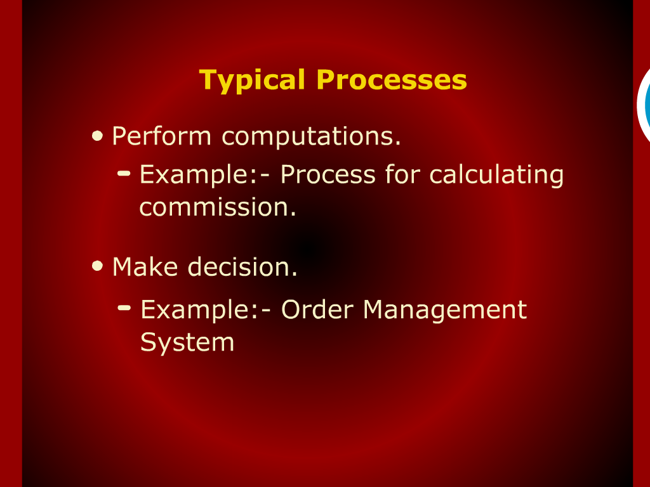
Typical Process

Slide 3
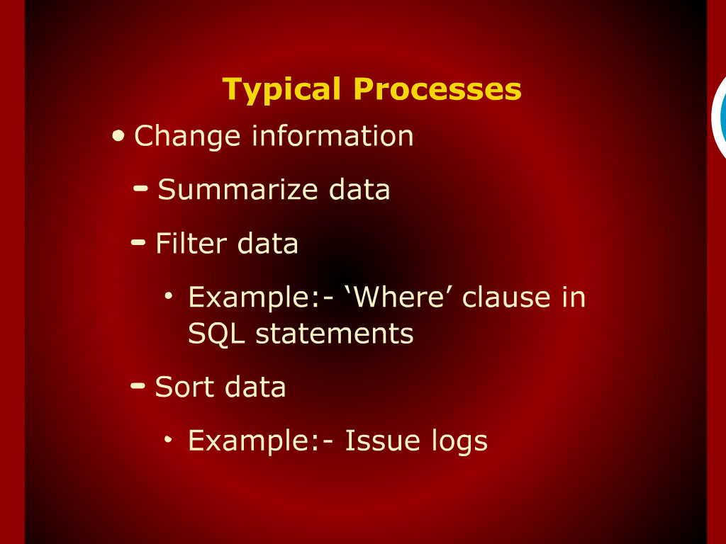

Slide 4
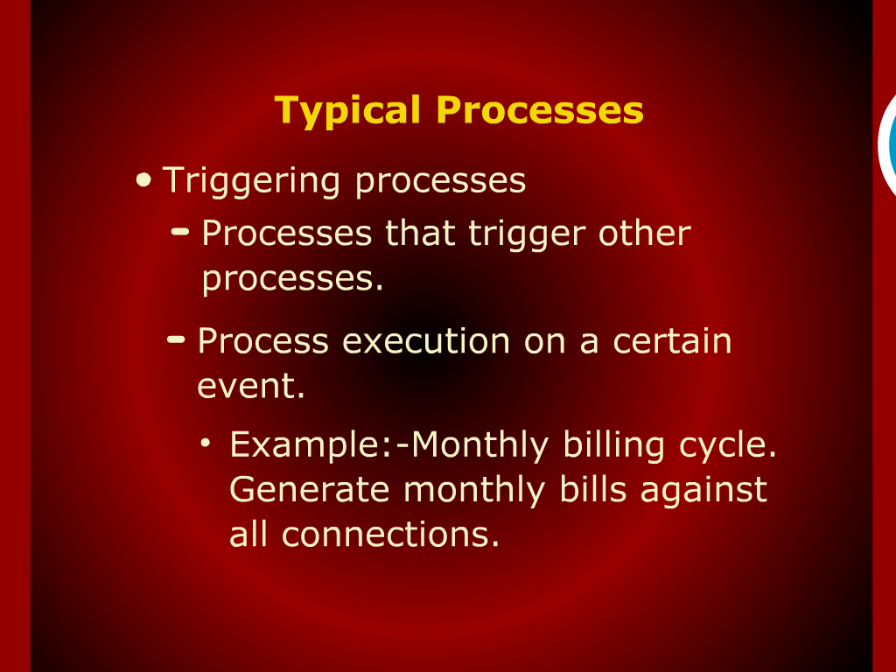

Slide 5
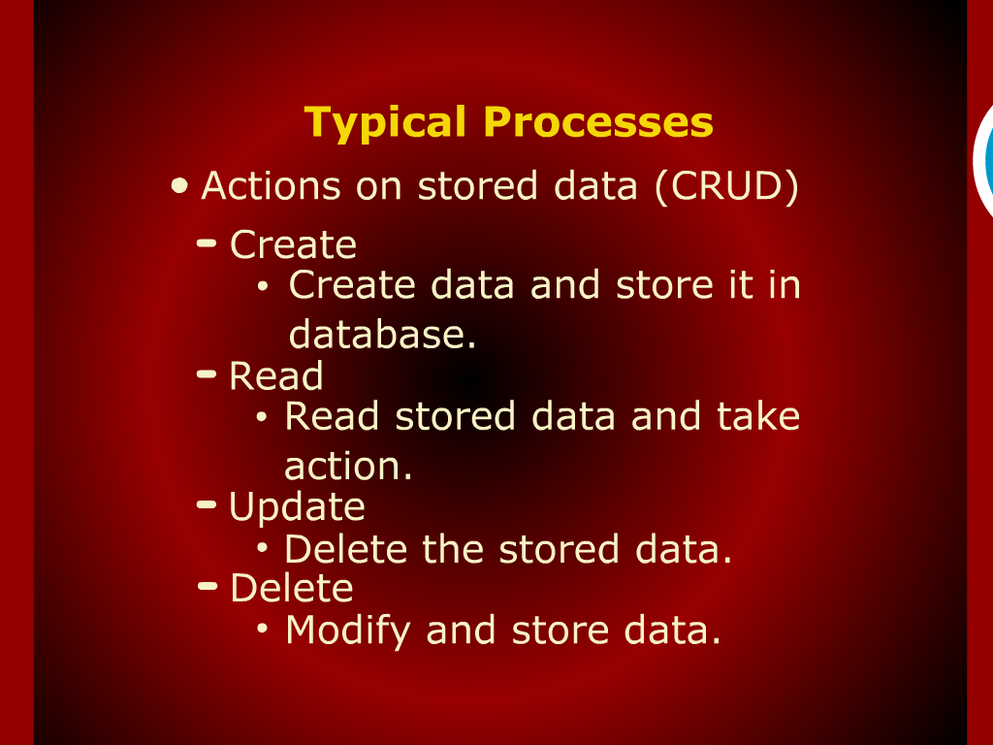

Slide 6
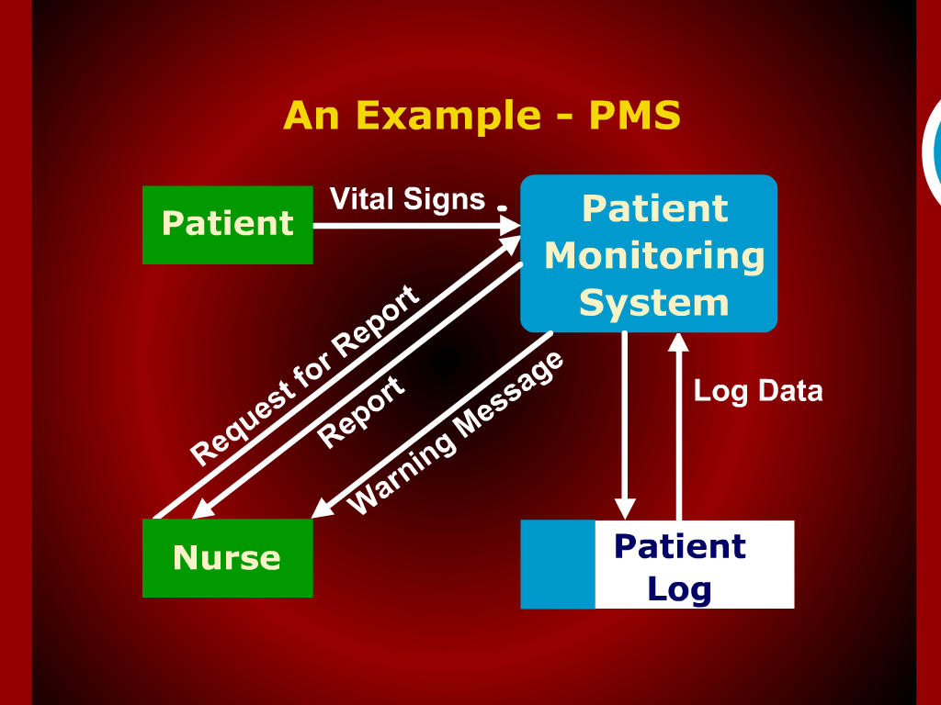

Slide 7
What to Show?

Slide 8
Levels of Abstraction

Slide 9
Tabular Structures

Slide 10
Data Flow Diagrams

Slide 11
Common Mistakes
Employee
Generate an
employee
bank stmt
Bank Statement
insufficient input data
Existing
Accounts
Employee
Address
This process has no inputs
Membership Application
Create a new
member
account
Member
Accounts
Employees
Employee
Status
New
Account
Status
This process has no outputs
Frozen
Account
Notification
Accounts
Receivable
Department
Freeze
member
account

Slide 12
Illegal Data Flows
✗
B1
B2
A process is
needed to
exchange data
between
external agents
B1
B2

Slide 13
Illegal Data Flows
✗
B1
Data
Store
A process is
needed to
update a data
store
B1
Data
Store

Slide 14
Illegal Data Flows
✗
B1
Data
Store
A process is
needed to
use a data
store
B1
Data
Store

Slide 15
Illegal Data Flows
✗
Data
Store
Data
Store
A process is
needed to
copy data from
one data store
to another
Data
Store
Data
Store

